Slide 1
Establishing the Best Lensing Candidates for JWST
Jake Vehonsky
Senior, Mechanical Engineering Student
Mentor: Dr. Rogier Windhorst
ASU School of Earth and Space Exploration
Arizona Space Grant Symposium, Tucson, AZ, April 15, 2016

Slide 2
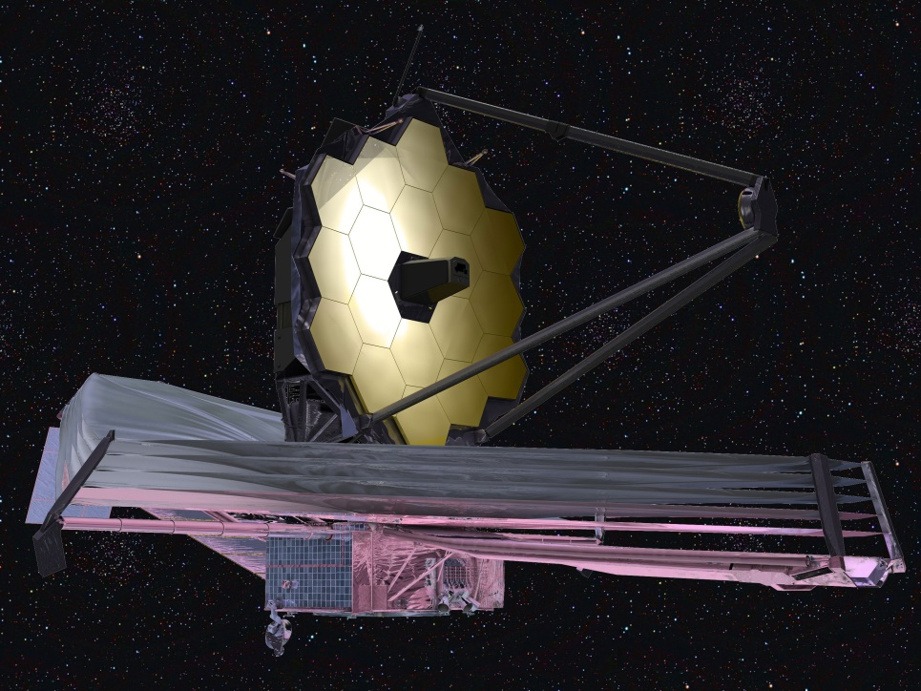
James Webb Space Telescope
Set to launch at the end of 2018
Infrared telescope with a
wavelength range of 0.6 – 28.5
microns
Primary mirror has a diameter of
6.5m, which gives a collecting
area that is 7 times larger than HST
The main goal of JWST is to observe the light from galaxies at very high redshifts (z=10). This light will have originated only a few hundred million years after the Big Bang!
Photo Courtesy of astrobites.org writer Natasha Batalha

Slide 3
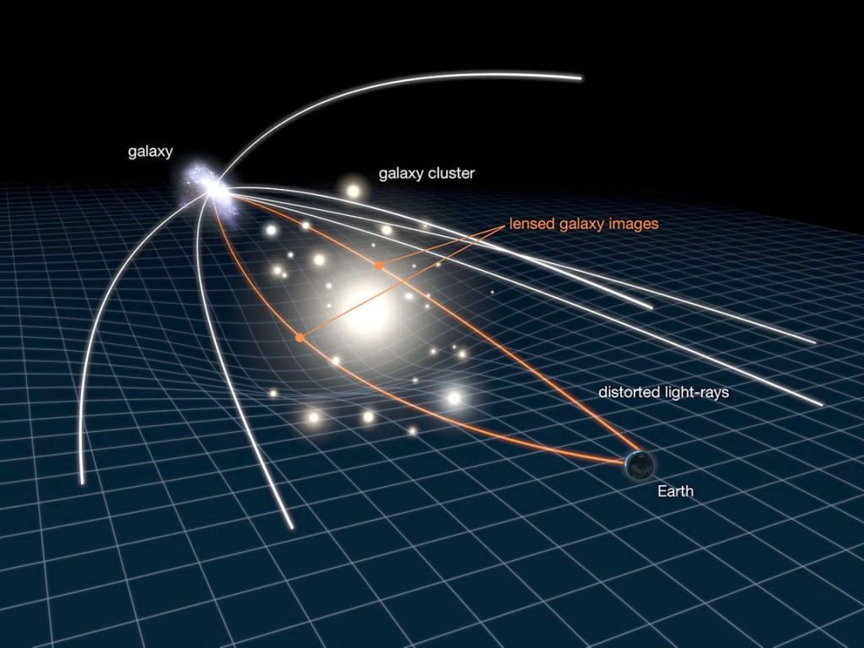
How Can We See These Galaxies?
Einstein’s General Theory of Relativity provides the physics behind the observations
Large galaxy clusters warp the surrounding fabric of space-time, warping light from background objects
These galaxies are often called “gravitational lenses” because they magnify and warp the light that passes through them
Photo courtesy of NASA/ESA
The chances of having a background z=10 galaxy aligned in a way that a very large galaxy cluster lenses the object’s light are rare, so we must find the clusters that give us the highest chance of observing them (i.e. the best gravitational lenses).

Slide 4
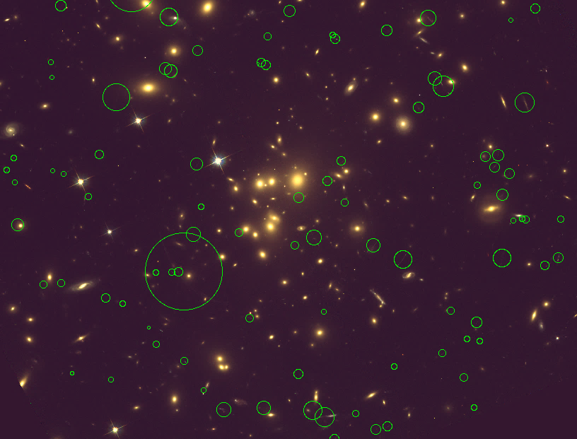
So, what Makes a Good Lens?
Super massive dark matter halo
    Measured using the velocities of the constituent galaxies around the center of the cluster center
    Estimates of the required mass for strong lenses are > 10¹⁴ M_{ʘ}
Compact composition of the cluster
    Quantified by the concentration
      index, which is a measure of how
      centrally located the dark matter
      halo of the galaxy cluster is (C ≳ 2)
(Right): Section of Abell 1689 with arcs and lensed objects circled in green.

Slide 5
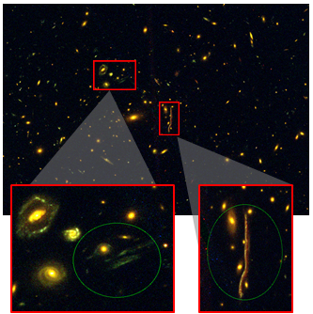
Examining CLASH Clusters
Cluster Lensing And Supernova survey with Hubble
A panchromatic survey of 25 galaxy clusters (16 filters)
The clusters were analyzed in SAO Image (DS9) with data from the F435w (blue), F606w (green), and F814w (red) filter observations
An RGB image was made for each cluster to make finding arcs and lensed objects easier
(Left): An example RGB image of the MACSJ1206-08 galaxy cluster with examples of lensed objects highlighted.

Slide 6
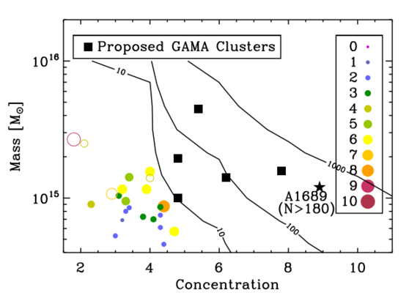
Results
Contour plot estimate of the number of lensed objects found in a galaxy cluster based on its mass and concentration.
Actual lensed object counts for CLASH clusters are overlaid in color
Plot courtesy of Seth Cohen

Slide 7
Conclusions
The results from the plot show a good agreement between the predicted number of arcs and lensed objects and the observed number for the CLASH clusters.
Because of this, galaxy clusters with higher masses and concentrations should be studied to see if this agreement is still true for clusters predicted to have 10s or 100s of arcs.
Hubble proposals have been submitted to view 5 clusters that fall under this description in the F606w filter before HST is decommissioned, as JWST will not have viewing capacity in those wavelength ranges

Slide 8
Acknowledgments
I would like to my mentor Dr. Rogier Windhorst as well as Teresa Ashcraft, Seth Cohen, Bhavin Joshi, Rolf Jansen, and the rest of the Windhorst Cosmology Graduate Research Lab for always setting their own time aside to help me during this project. I would also like to thank NASA, ASU, SESE, and the rest of the Space Grant affiliates for allowing me to partake in meaningful scientific research this year.

Slide 9
Questions?

